Slide 1


AIBridge
The Generative Revolution
1

Slide 2
Today’s AI is already extremely versatile. But where are we headed in the future?

Slide 3
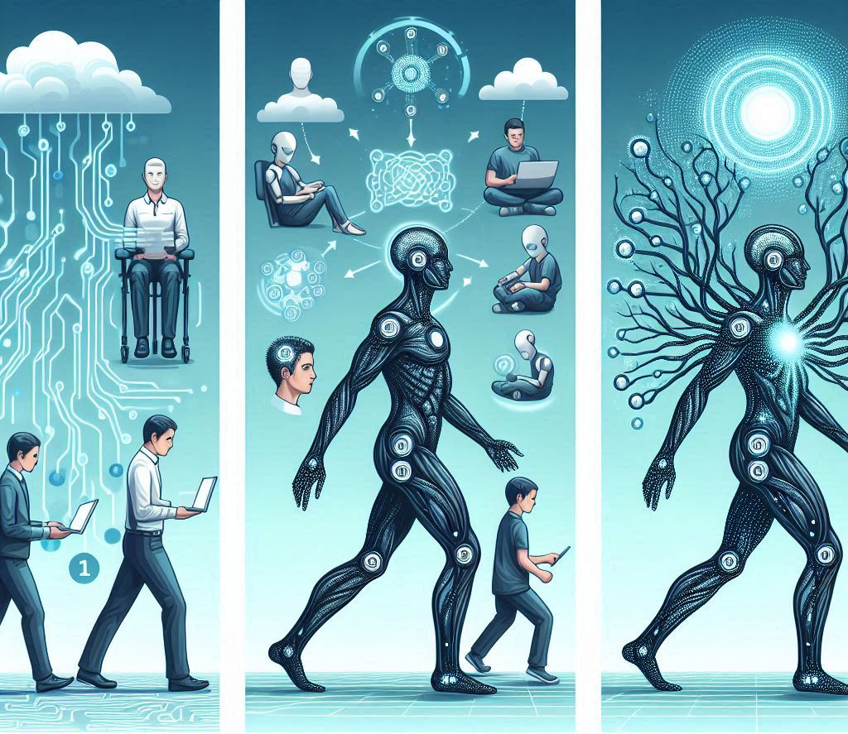
Catalyst, collaborator, consummation

Slide 4
The short-term goal: catalysing productivity

Slide 5
Stage 1: Catalyst
Aiding human productivity
“Weak” AI: humans need to be in the loop
Notes:
Right now, AI cannot truly “think” with humans, and instead are more focused on menial retrieval and structural generation tasks, as we’ll see later on in this lecture.
Explanation of present-day AI as "weak" AI, requiring human-in-the-loop feedback, prompt engineering, and other interventions.

Slide 6
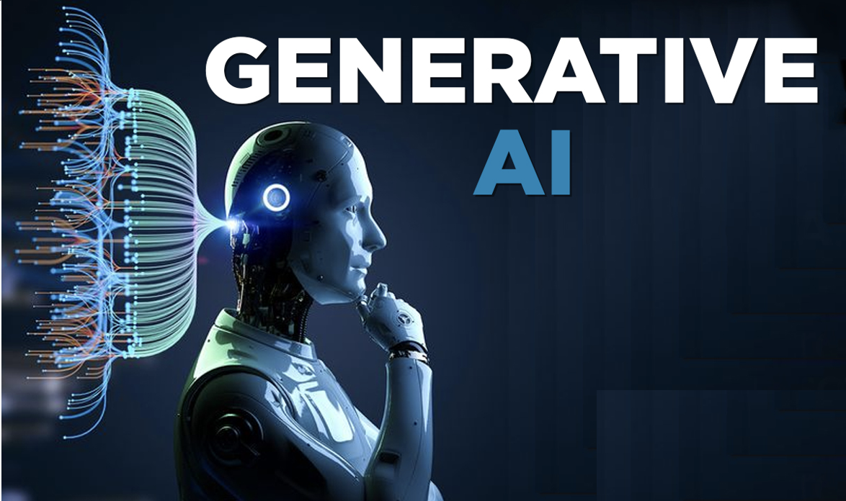
Stage 1: Catalyst
Aiding human productivity
“Weak” AI: humans need to be in the loop
Notes:
Right now, AI cannot truly “think” with humans, and instead are more focused on menial retrieval and structural generation tasks, as we’ll see later on in this lecture.
Explanation of present-day AI as "weak" AI, requiring human-in-the-loop feedback, prompt engineering, and other interventions.

Slide 7
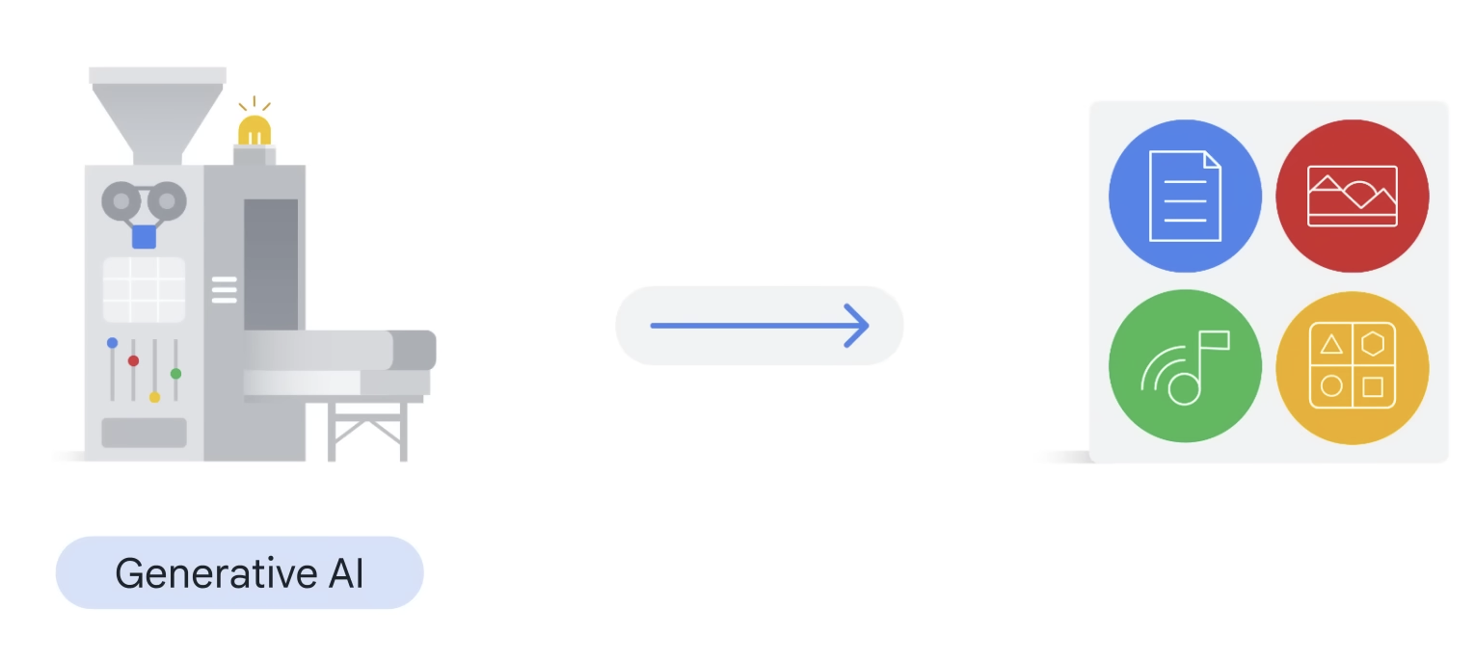
Generative AI
Underlying patterns to new content.
The link between structure and meaning
Notes:
Right now, AI cannot truly “think” with humans, and instead are more focused on menial retrieval and structural generation tasks, as we’ll see later on in this lecture.
Explanation of present-day AI as "weak" AI, requiring human-in-the-loop feedback, prompt engineering, and other interventions.

Slide 8
Case study: LLMs

Slide 9
Why “large language models”?

Slide 10
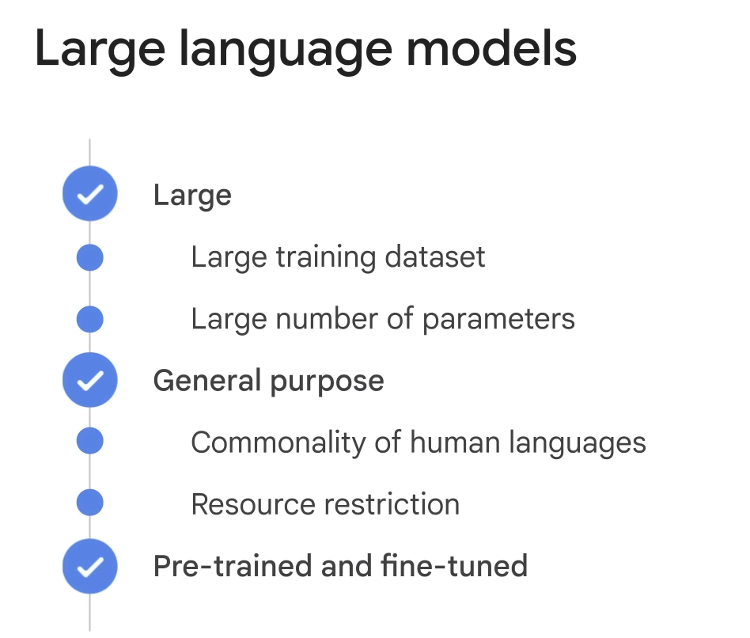
Notes:
When people think about LLM, then tend to think about model size. Equally important is its training datasize. Current large LLMs often use corpus of trillionons of words. More importantly, LLMs are often trained as general purpose models. In other words, it learns the commonality of human languages, as we described earlier. For such large efforts, not many companies/organizations/people can afford. Only a few large cooperations. Therefore, these models are often pretrained and can be fine-tuned to do specific tasks. For example, chatCPT is often said to use pretrained GPT 3 or now GPT 4 and fine tuned. We will talk about fine tuning in a few slides.
In a large language model (LLM), such as GPT-3, the model takes raw input as text in a sequential manner. The input text is typically passed to the model in the form of a string or a list of strings. When feeding the input to the model, it is important to consider the maximum token limit imposed by the model. Tokens are chunks of text that the model processes, and each token can be as short as one character or as long as one word, depending on the tokenizer used. The maximum token limit varies depending on the specific model variant, with GPT-3 having a limit of 4096 tokens.
After the input text is tokenized, it is converted into numerical representations called embeddings, which capture the semantic meaning of the tokens. These embeddings are then processed by the model's neural network,

Slide 11
How LLMs work
LLMs generate text token by token.
They work probabilistically.
Notes:
Right now, AI cannot truly “think” with humans, and instead are more focused on menial retrieval and structural generation tasks, as we’ll see later on in this lecture.
Explanation of present-day AI as "weak" AI, requiring human-in-the-loop feedback, prompt engineering, and other interventions.

Slide 12
Stage 1: LLMs
What is next-token prediction?
Notes:
Right now, AI cannot truly “think” with humans, and instead are more focused on menial retrieval and structural generation tasks, as we’ll see later on in this lecture.
Explanation of present-day AI as "weak" AI, requiring human-in-the-loop feedback, prompt engineering, and other interventions.

Slide 13
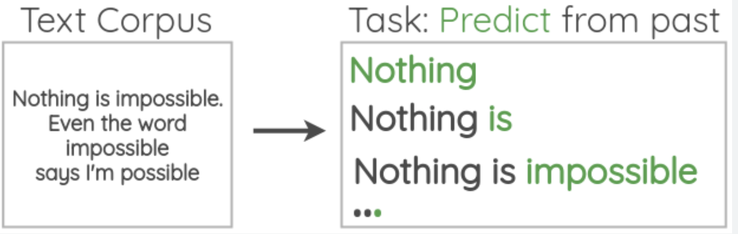
How we train LLMs
Notes:
It builds up on a clear idea. Huam language is abundant, especially in the Internet ero. There are textbooks, Wikipedia, journal articles, or just webcrawling. There is almost unlimited text out there.

Slide 14
How we train LLMs
Text input
GPT
Next word

Slide 15
How we train LLMs
0.9
0.05
0.03
0.02
This one!
Text input
GPT
Notes:
This is a very critical concept. This is why ChatGPT generates different answers if you try at multiple times. This is also the generation part. Why it is not “accurate”. It is not supposed to be ”accurate”. It meant to mimic human language.

Slide 16
How we train LLMs
Now we repeat and generate more text!
“Hi, how”
GPT
“are”

Slide 17
How we train LLMs
Now we repeat and generate more text!
“Hi, how are”
GPT
“you”

Slide 18
How we train LLMs
Now we repeat and generate more text!
“Hi, how are you”
GPT
“today?”

Slide 19
Stage 1: How LLMs work
Now we repeat and generate more text!
GPT
“Hi, how are you today?”

Slide 20
Stage 1: Training LLMs
How are LLMs then trained to do this as well as possible?
Notes:
Right now, AI cannot truly “think” with humans, and instead are more focused on menial retrieval and structural generation tasks, as we’ll see later on in this lecture.
Explanation of present-day AI as "weak" AI, requiring human-in-the-loop feedback, prompt engineering, and other interventions.

Slide 21
Stage 1: Training LLMs
How are LLMs then trained to do this as well as possible?
Self-supervised learning.
Notes:
Right now, AI cannot truly “think” with humans, and instead are more focused on menial retrieval and structural generation tasks, as we’ll see later on in this lecture.
Explanation of present-day AI as "weak" AI, requiring human-in-the-loop feedback, prompt engineering, and other interventions.

Slide 22
Stage 1: Training LLMs
The process behind self-supervised learning
“Hi, how are you today?”
Notes:
Right now, AI cannot truly “think” with humans, and instead are more focused on menial retrieval and structural generation tasks, as we’ll see later on in this lecture.
Explanation of present-day AI as "weak" AI, requiring human-in-the-loop feedback, prompt engineering, and other interventions.

Slide 23
Stage 1: Training LLMs
The process behind self-supervised learning
Hi | how | are | you | today
Notes:
Right now, AI cannot truly “think” with humans, and instead are more focused on menial retrieval and structural generation tasks, as we’ll see later on in this lecture.
Explanation of present-day AI as "weak" AI, requiring human-in-the-loop feedback, prompt engineering, and other interventions.

Slide 24
Stage 1: Training LLMs
The process behind self-supervised learning
xxxxx | how | are | xxxxx | today
Notes:
Right now, AI cannot truly “think” with humans, and instead are more focused on menial retrieval and structural generation tasks, as we’ll see later on in this lecture.
Explanation of present-day AI as "weak" AI, requiring human-in-the-loop feedback, prompt engineering, and other interventions.

Slide 25
Stage 1: Training LLMs
The process behind self-supervised learning
xxxxx | how | are | xxxxx | today
Task: predict the missing words as best as possible.
Notes:
Right now, AI cannot truly “think” with humans, and instead are more focused on menial retrieval and structural generation tasks, as we’ll see later on in this lecture.
Explanation of present-day AI as "weak" AI, requiring human-in-the-loop feedback, prompt engineering, and other interventions.

Slide 26
Stage 1: Training LLMs
The process behind self-supervised learning:
Take a piece of the training corpus
Redact certain words in the corpus
Train to predict those words
Repeat and magnify across the whole training corpus.
Notes:
Right now, AI cannot truly “think” with humans, and instead are more focused on menial retrieval and structural generation tasks, as we’ll see later on in this lecture.
Explanation of present-day AI as "weak" AI, requiring human-in-the-loop feedback, prompt engineering, and other interventions.

Slide 27
What’s next?

Slide 28
Stage 1: Fine-tuning the LLM
The ability to generate text that makes sense is not equivalent to the ability to have conversations.
The process of fine-tuning
Notes:
Right now, AI cannot truly “think” with humans, and instead are more focused on menial retrieval and structural generation tasks, as we’ll see later on in this lecture.
Explanation of present-day AI as "weak" AI, requiring human-in-the-loop feedback, prompt engineering, and other interventions.

Slide 29
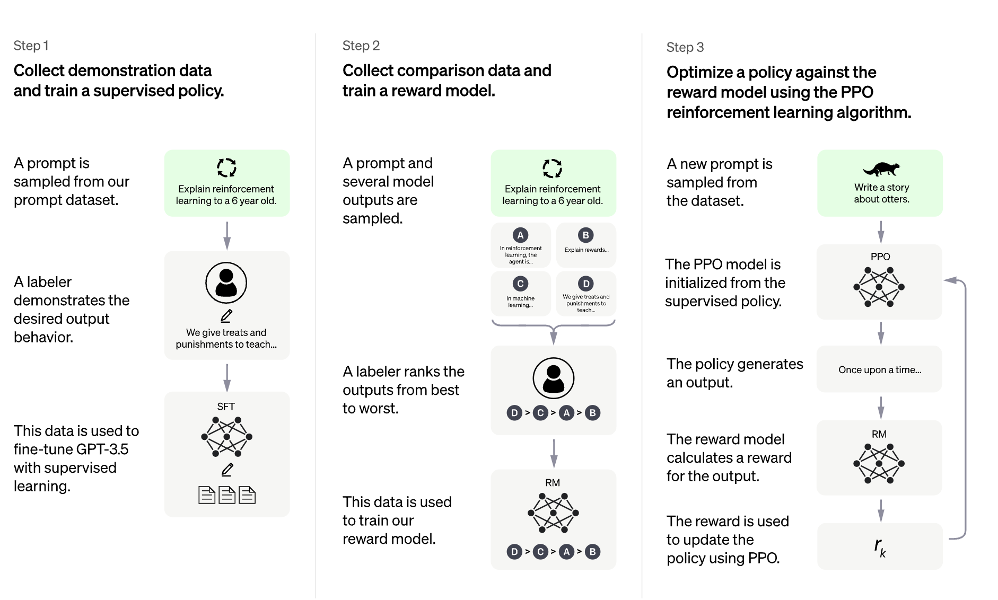
Stage 1: Fine-tuning
Reinforcement-learning via human feedback (RLHF)
Notes:
Right now, AI cannot truly “think” with humans, and instead are more focused on menial retrieval and structural generation tasks, as we’ll see later on in this lecture.
Explanation of present-day AI as "weak" AI, requiring human-in-the-loop feedback, prompt engineering, and other interventions.

Slide 30
Stage 1: Fine-tuning
Step 1 – collect human feedback
Notes:
Right now, AI cannot truly “think” with humans, and instead are more focused on menial retrieval and structural generation tasks, as we’ll see later on in this lecture.
Explanation of present-day AI as "weak" AI, requiring human-in-the-loop feedback, prompt engineering, and other interventions.

Slide 31
“What is the highest mountain?”
“The highest mountain is Himalayas.”
Human
“A. Himalayas; B. K2; C. .”
Notes:
Next token generation can already be very powerful. But is it enough. For example, if we ask the model a question,… remember this is a probability model. So It is possible for it to generate multiple different answers. All similar to what it has seen. The first one is probably a correct answer it finds somewhere. The second could come from some Internet text when a teacher posted an exam multi-choice question. The third one could be a rhetorical question again seen in its corpus.All these are reasonable, human-like text. After all, we probably seen something like this in our daily language. But to answer the question, we probably want chatGPT to give us the first answer. To address this issue, it comes to be fine-tuning part of ChatGPT

Slide 32

“What is the highest mountain?”
“The highest mountain is Himalayas.”
Human
Human labeling
“A. Himalayas; B. K2; C. .”
Notes:
An interesting trick used here is that ranking is a lot easier than generating answers for human being.

Slide 33
Stage 1: Fine-tuning
This data is used to train a reward model.
Notes:
The human ratings and rankings collected in the previous step are used to train a separate model called the "reward model." This reward model learns to predict how humans would score or rank the responses generated by the LLM. Essentially, the reward model is trained to mimic human judgments and preferences, allowing it to assign a "reward" score to any given response from the LLM.

Slide 34
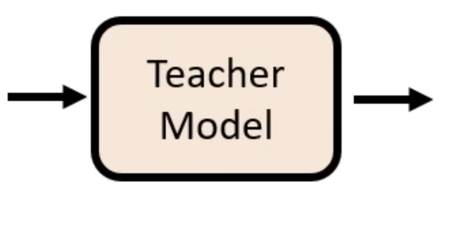
“The highest mountain is Himalayas.”
“A. Himalayas; B. K2; C. .”
Notes:
Such information is used to train a so-called teacher model. Basically, the teacher model learns how to compare answers. If the question and these two answers are given to the teacher model, at inference time, it tells us the first answer is better. Again this is upervised learning. The training dataset is generated (the ranks) by humans. At inference time, ,…

Slide 35
Stage 1: Fine-tuning
The reward model and new data are then used to actually fine-tune.
Notes:
The human ratings and rankings collected in the previous step are used to train a separate model called the "reward model." This reward model learns to predict how humans would score or rank the responses generated by the LLM. Essentially, the reward model is trained to mimic human judgments and preferences, allowing it to assign a "reward" score to any given response from the LLM.

Slide 36


“What is the highest mountain?”
“The highest mountain is Himalayas.”
GPT
Reward signal

Slide 37
Now that we’re familiar with LLMs…

Slide 38
Stage 1: Things to look out for
LLMs generate content probabilistically.
Because the goal of LLMs is to emulate human speech, they are susceptible to hallucinations.
Notes:
Right now, AI cannot truly “think” with humans, and instead are more focused on menial retrieval and structural generation tasks, as we’ll see later on in this lecture.
Explanation of present-day AI as "weak" AI, requiring human-in-the-loop feedback, prompt engineering, and other interventions.

Slide 39
Stage 1: Things to use AI for
“If I had to take one of the top use cases [for Microsoft Copilot], it’s summary. It’s helping people make content more digestible.”
            - Divya Kumar
            GM of search and AI marketing, Microsoft
Notes:
Right now, AI cannot truly “think” with humans, and instead are more focused on menial retrieval and structural generation tasks, as we’ll see later on in this lecture.
Explanation of present-day AI as "weak" AI, requiring human-in-the-loop feedback, prompt engineering, and other interventions.

Slide 40
In fact, we’re so confident in AI that…
Notes:
We’re willing to bet someone, anyone in this room here, that they can’t read a new article that they haven’t seen before faster than AI can read that same article that it hasn’t seen before. If you do it successfully, we’ll be in negotiations to get you (delicious food item) tomorrow morning.

Slide 41
Anything else?

Slide 42
Things we’re using AI for
Content summary – a lot of information coming in at once
Retrieval and synthesis
Structure generation: text, code, and much more!
Notes:
There are also a lot of LLM tools e.g. GPT store, which are fine-tuned for a lot of different purposes. You can explore everywhere if you want, but we're going to give you one example.

Slide 43
CASE STUDY: Solving a coding problem with AI

Slide 44
Let’s say I want to build my own logistic regression model. What would I need?

Slide 45
But first…

Slide 46
LLM Tips
Be as specific as possible
The power of “Act as if…”
Have it explain its thoughts step-by-step
“Be concise”

Slide 47
Chatbot Workflow
1. Brainstorm what we need…with the help of AI!
Notes:
Prompt: Act as if you're a thoughtful and highly experienced software developer. I want advice on what intermediate packets I would need in order to build my own highly effective logistic regression model.
In the development process, I would like to use only Python as the language in the backend, specifically with the packages pandas and scikit-learn. Assume we're going to use the iris dataset from the load_iris function.
Please provide me a list in order from most to least important, and give a short explanation about what each element might entail and why it's important.

Slide 48
Chatbot Workflow
Brainstorm what we need…with the help of AI!
Turn the ideas into a workflow…with the help of AI!
Notes:
Prompt: Given these ideas, can you now generate me a step-by-step workflow that you would use to code the logistic regression model? You don't need to generate any code, just describe how it would work.

Slide 49
Chatbot Workflow
Brainstorm what we need…with the help of AI!
Turn the ideas into a workflow…with the help of AI!
Edit the workflow as necessary.
Notes:
Prompt: We will now enter an editing phase in order to modify the workflow as thoroughly as possible. For each round, you will prompt the user for feedback, then ingress the feedback, make changes, and rewrite the workflow given above. Keep prompting for feedback until the user is sufficiently satisfied with the workflow.
Edit #1: Assume we're going to be coding in Google Colab. Assume also that the model is just for personal use, so it doesn't need to be deployed or saved anywhere and can be kept within Colab. Would the workflow then change?
ASK AUDIENCE FOR FURTHER EDITS, ETC.

Slide 50
Chatbot Workflow
Brainstorm what we need…with the help of AI!
Turn the ideas into a workflow…with the help of AI!
Edit the workflow as necessary.
Execute the workflow…with the help of AI!*
Notes:
Prompts:
Are you able to explore the iris dataset for me? If so, can you provide me with a series of explicit conclusions?
Given these explicit conditions, can you give me 3-5 preprocessing steps that you would do for this dataset? Please be as specific as possible to the point of writing pseudocode.
Can you go ahead and write the code for everything up to Step 9?
If you were to generate a series of 50 completely new test data points, could you describe a step-by-step workflow for doing this?
Can you use the workflow you just described to generate a series of 20 new test data points, then evaluate the Logistic Regression model you generated with those new datasets?
Etc.

Slide 51
CASE STUDY: Making a demo slide deck with AI

Slide 52


Case study: Workflow
Understanding our tools
Notes:
Right now, AI cannot truly “think” with humans, and instead are more focused on menial retrieval and structural generation tasks, as we’ll see later on in this lecture.
Explanation of present-day AI as "weak" AI, requiring human-in-the-loop feedback, prompt engineering, and other interventions.

Slide 53
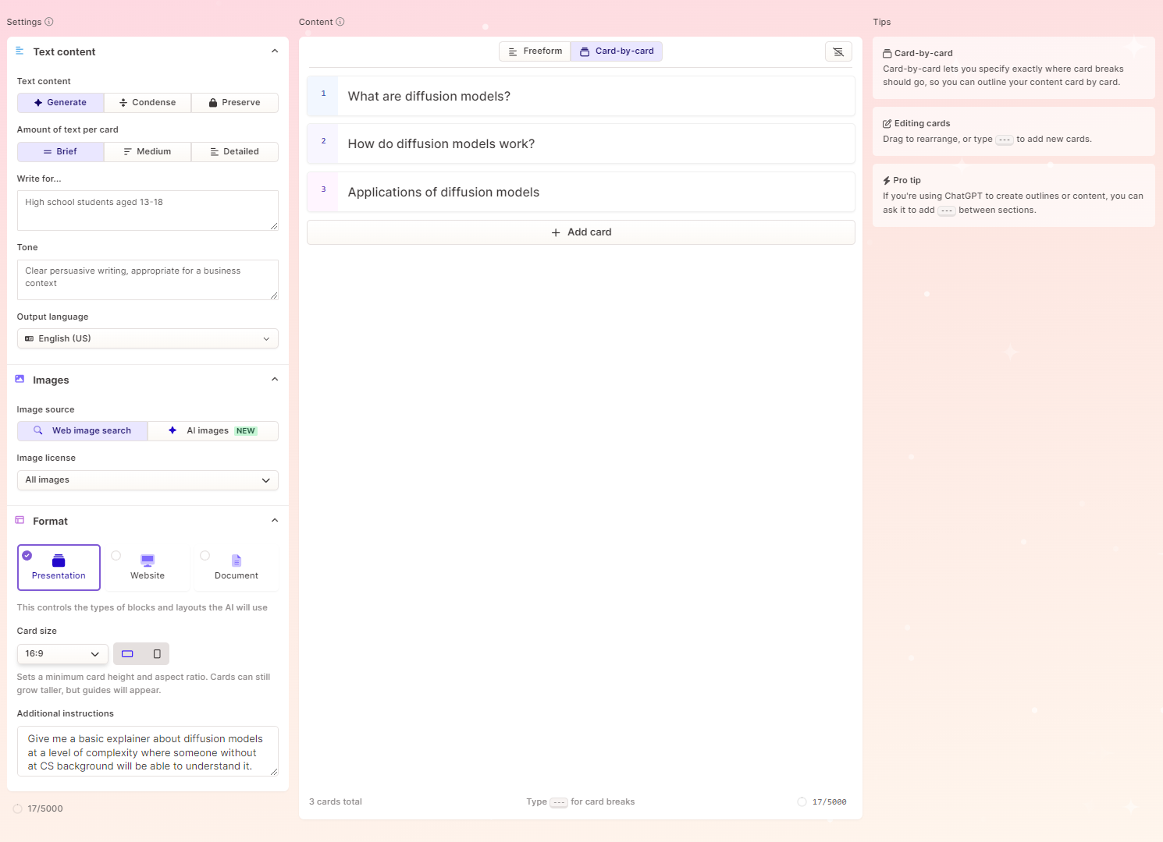
Case study: Understanding Gamma
2. Audience and Tone: Where we plug in a description of the target audience the presentation will be made for, and the tone we want the presentation to take on.
1. Cards: Where the actual content of the presentation is actually contained and written. This is where we will put in an outline of the content we want to generate.
3. Additional Instructions: We can add additional fine-tuning instructions for the generation engine, such as what to emphasise, whether to add more images or text, etc.
Notes:
Right now, AI cannot truly “think” with humans, and instead are more focused on menial retrieval and structural generation tasks, as we’ll see later on in this lecture.
Explanation of present-day AI as "weak" AI, requiring human-in-the-loop feedback, prompt engineering, and other interventions.

Slide 54
Does anyone want to suggest a workflow?

Slide 55
Case study: Workflow
Given a repository of content (e.g. our original slides!), have ChatGPT generate an outline.
Format the outline into Gamma cards (i.e. separated by the “---” delineator).
Input into Gamma.
Generate your presentation!
Notes:
Right now, AI cannot truly “think” with humans, and instead are more focused on menial retrieval and structural generation tasks, as we’ll see later on in this lecture.
Explanation of present-day AI as "weak" AI, requiring human-in-the-loop feedback, prompt engineering, and other interventions.

Slide 56
Here’s an example presentation:

Slide 57

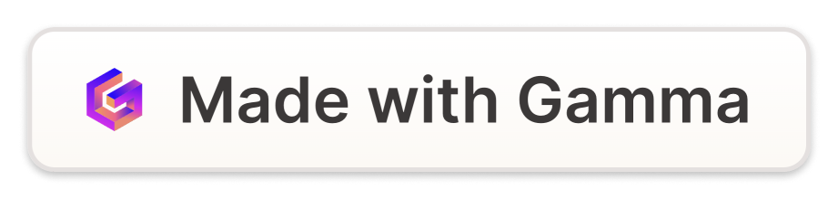
Introduction to Python

Slide 58
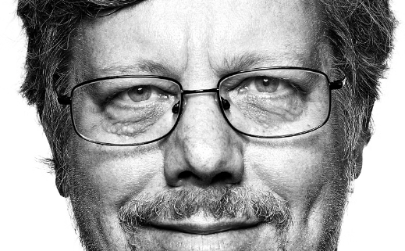
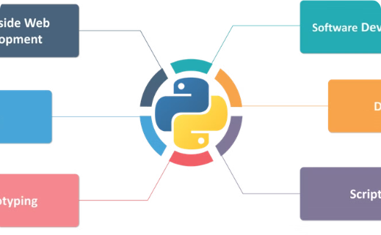
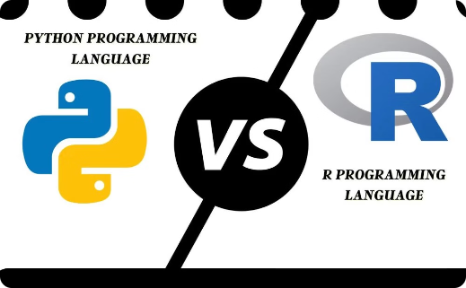
Python's Origin and Uses
Invention: 1980s
Versatile Applications
Comparison to R
Invented by Guido van Rossum
Python is used for web development, data analytics, machine learning, and more.
Python's versatility and performance make it a popular choice over R.

Slide 59




Google Colab
Google Drive
Shareable
No Setup
Pre-installed
Stores everything on Google Drive for easy access.
Easily share and collaborate on notebooks.
No installation required, just open in the browser.
Most popular packages and libraries are pre-installed.

Slide 60
General Python Syntax
Comments
Functions
Use # to add comments for code readability
Take inputs and give outputs:
# I am a comment!
print("hello world")
Prints the given input (in this case, "hello world").

Slide 61
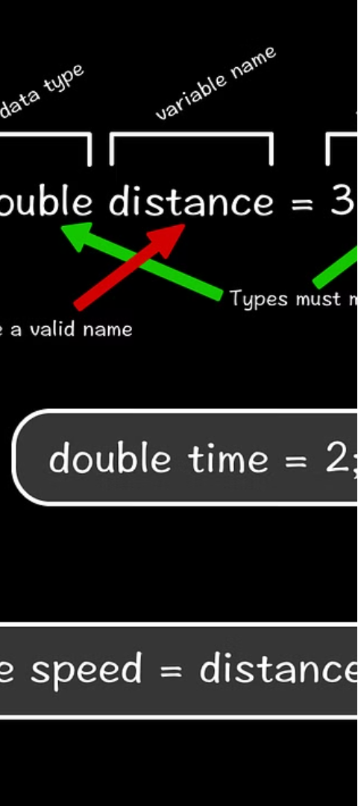
Variables Overview
Containers for Values
Variable Creation
Variables store different types of data.
Assign values using variable_name = value.
Usage
Reassignment
Variables can be used after they're assigned
Variables can be reassigned as needed

Slide 62

Variable Names
Naming Rules
Good Practices
Avoid Confusion
Cannot start with a number, no spaces, cannot be a keyword.
Use descriptive names, all lowercase with underscores.
Follow conventions to make code more readable and maintainable.

Slide 63
What do we think?

Slide 64
Overall: not bad, but there’s still room for improvement.

Slide 65
TAKEAWAYS

Slide 66
Using ChatGPT in the real world
How can we make LLMs useful?
Remember, LLMs are probabilistic.
We need to ask good questions.

Slide 67
Using ChatGPT in the real world
So what are good questions?
Give specific instructions to ChatGPT
  Make sure you leave little to no room for error!
Treat the answers like suggestions, not facts
  It’s good at a lot of things, but not great at one particular thing
  The niche problem

Slide 68
In general, treat it like you’re talking to another person!

Slide 69
Can ChatGPT answer every question?
Notes:
ChatGPT provides good informational prompts and entry points to research. However, the more specialized it gets, the more problems it brings up. As you saw in the case of creating the polynomial regression model, it does something that (1) provides errors and (2) gives you moderately inaccurate information.

Slide 70
Perhaps not…

Slide 71
ChatGPT limitations
Much like a person, ChatGPT has its own limitations:
It lacks truthfulness.
When researching in a highly specialized niche, it tends to begin making up false information or information riddled with errors.
Speed and efficiency of usage

Slide 72
Still, it’s a very powerful tool.

Slide 73
  Alright!
  Let’s get to the lab.

